Slide 1
Pizza Sales Analysis SQL Project
Mr. Jay Jitesh Chavan
Data Analyst

Slide 2

INTRODUCTION
This project provides a comprehensive learning experience with SQL, covering a wide range of topics from basic to advanced levels.
The project revolves around a dataset, where you will apply various SQL queries to extract, manipulate, and analyze data, solving real-world problems as you progress.
The project focuses on deepening your understanding of SQL fundamentals while advancing to complex data manipulation, optimization, and reporting techniques.

Slide 3
Steps to Set Up and Work with MySQL
1. Install MySQL Command Line and MySQL Workbench
Download and install the necessary MySQL tools (Command Line Client and Workbench) from the official MySQL website.
2. Create a New Database
Use either MySQL Command Line or Workbench to create a new database using SQL queries or the graphical interface.
3. Select the Database
Ensure the correct database is selected using the “USE" command or via the Workbench interface for further operations.

Slide 4
Continue..
4. Import Tables
Import existing tables into your database using SQL scripts or the import functionality in MySQL Workbench.
5. Import Datasets from a Local Device
Upload datasets from your local machine into the selected database using CSV or other file formats supported by MySQL.
6. Execute SQL Queries
Write and run SQL queries to interact with and analyze the data within your database.

Slide 5
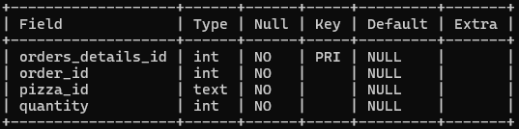
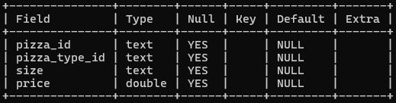
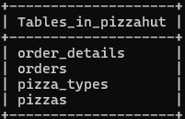
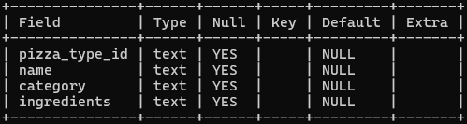
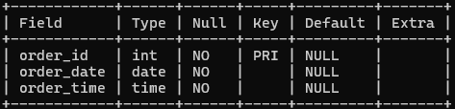
TOTAL TABLES
Order Details
Pizzas
Pizza Types
Orders

Slide 6



BASIC QUERIES

Slide 7
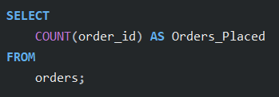
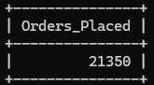
Retrieve the total number of orders placed.

Slide 8
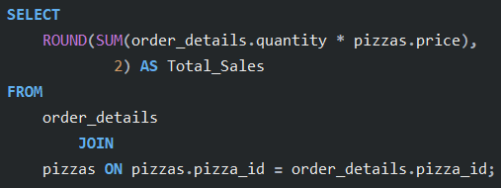
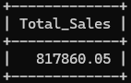
Calculate the total revenue generated from pizza sales.

Slide 9
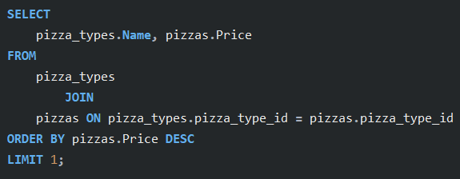
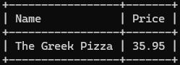
Identify the highest-priced pizza.

Slide 10
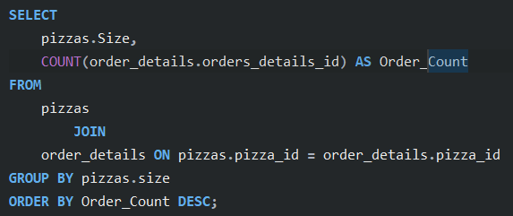
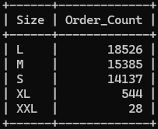
Identify the most common pizza size ordered.

Slide 11
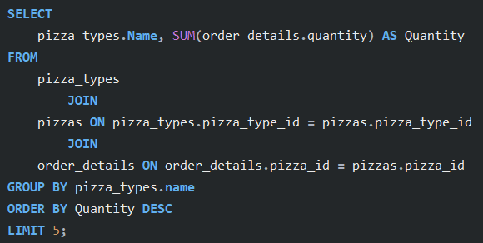
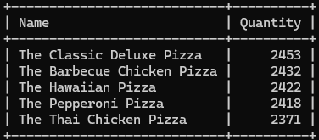
List the top 5 most ordered pizza types along with their quantities.

Slide 12
INTERMEDIATE QUERIES

Slide 13
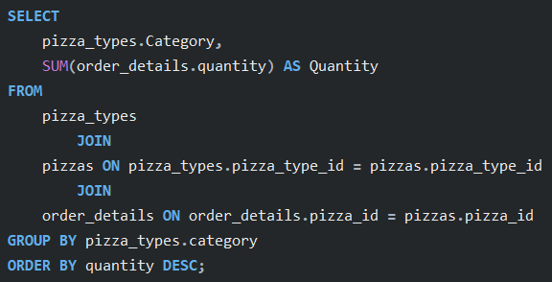
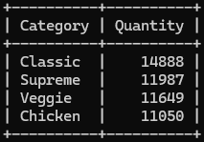
Join the necessary tables to find the total quantity of each pizza category ordered.

Slide 14
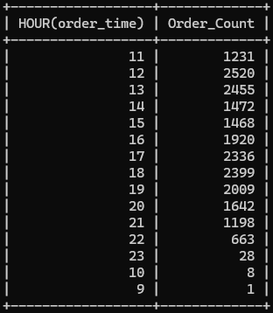
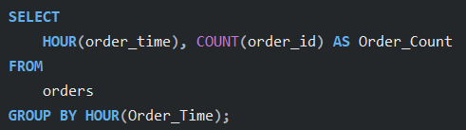
Determine the distribution of orders by hour of the day.

Slide 15
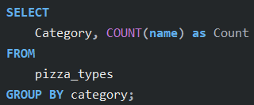
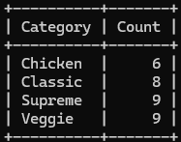
Join relevant tables to find the category-wise distribution of pizzas.

Slide 16
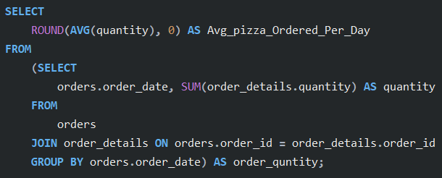
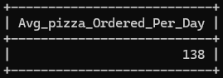
Group the orders by date and calculate the average number of pizzas ordered per day.

Slide 17
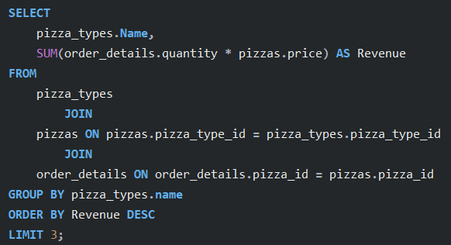
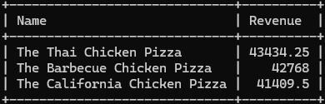
Determine the top 3 most ordered pizza types based on revenue.

Slide 18
ADVANCED QUERIES

Slide 19
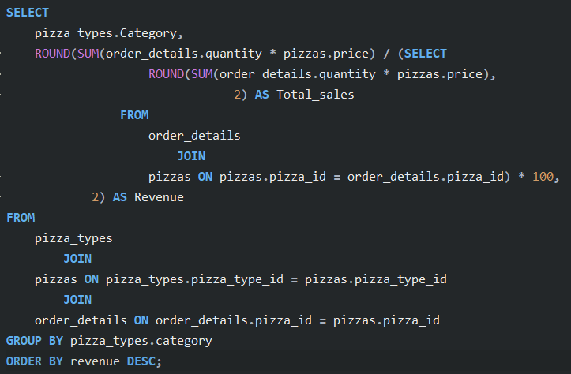
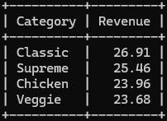
Calculate the percentage contribution of each pizza type to total revenue.

Slide 20
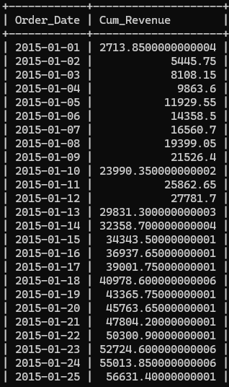
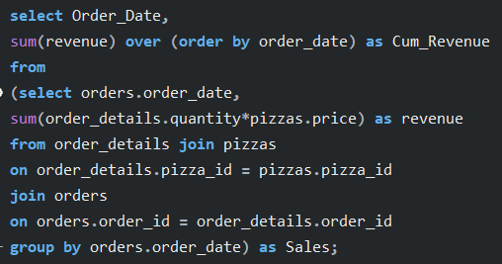
Analyze the cumulative revenue generated over time.

Slide 21
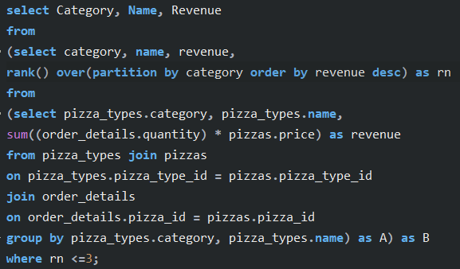
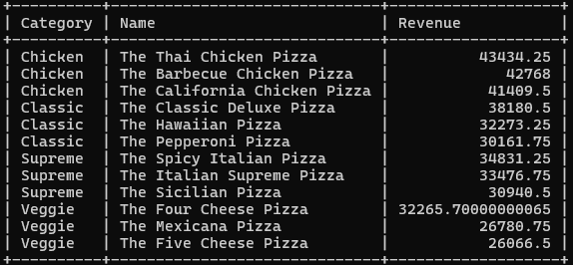
Determine the top 3 most ordered pizza types based on revenue for each pizza category.

Slide 22
THANK YOU..😊

